Slide 1
Hotel management System
Nidhi Parmar, Kyle Austin, Rika Siddiquee, Wiley Jackson, Tahsina Sultana, Norris Wise

Slide 2
Customers
HOTEL
Amenities
Rooms
Staff

Slide 3
Objective of Program
This program is designed to implement a hotel management system that will allow a costumer to check in to a room for an allotted time and be able to enjoy all the luxuries that our hotel offers.

Slide 4
Hotel
200 rooms
Hotel Staff
Amenities
Customers privileges

Slide 5
Rooms
There will be 200 rooms in our hotel for which a guest will be able to check into
3 types
Suites
Standard
Handicapped

Slide 6
Standard In Room Privileges
Each standard room will have these given amenities:
Television
Iron
Fridge
Couch
Telephone
Microwave
Safe

Slide 7
Suite in Room Privileges
Each suite will have all amenities that are included in a standard as well as the some additional items that are only available for a suite
Coffee Maker
Stereo System
Mini-bar

Slide 8
Handicap Room Privileges
Each Handicap room will have all amenities that are included in a standard as well as the some additional items that are only available for a Handicap
Fire alarm pull system
Walk-in showers

Slide 9
Staff
General Manager
House Keeper
Porter
Event Planner
Executive chef
Maintenance

Slide 10
Customer
Check in and check out date
Access to room specific amenities
Access to hotel amenities
Reserve 1-5 rooms

Slide 11
Amenities
Pool
Gym
Bar
Spa
Landry
Sports court
Game Room

Slide 12
First Build
Rooms
Check in and checkout date
Able to take in a persons name into a database
Able to choose between a three specific types of room
Regular room
Suite

Slide 13
UI
User interface that allows the user to take enter the following elements:
Check in
Check out
Room Type
Number of rooms

Slide 14
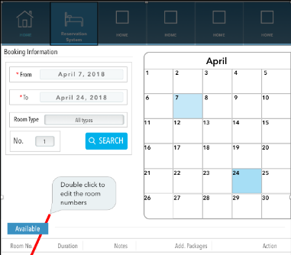
Ui prototype

Slide 15
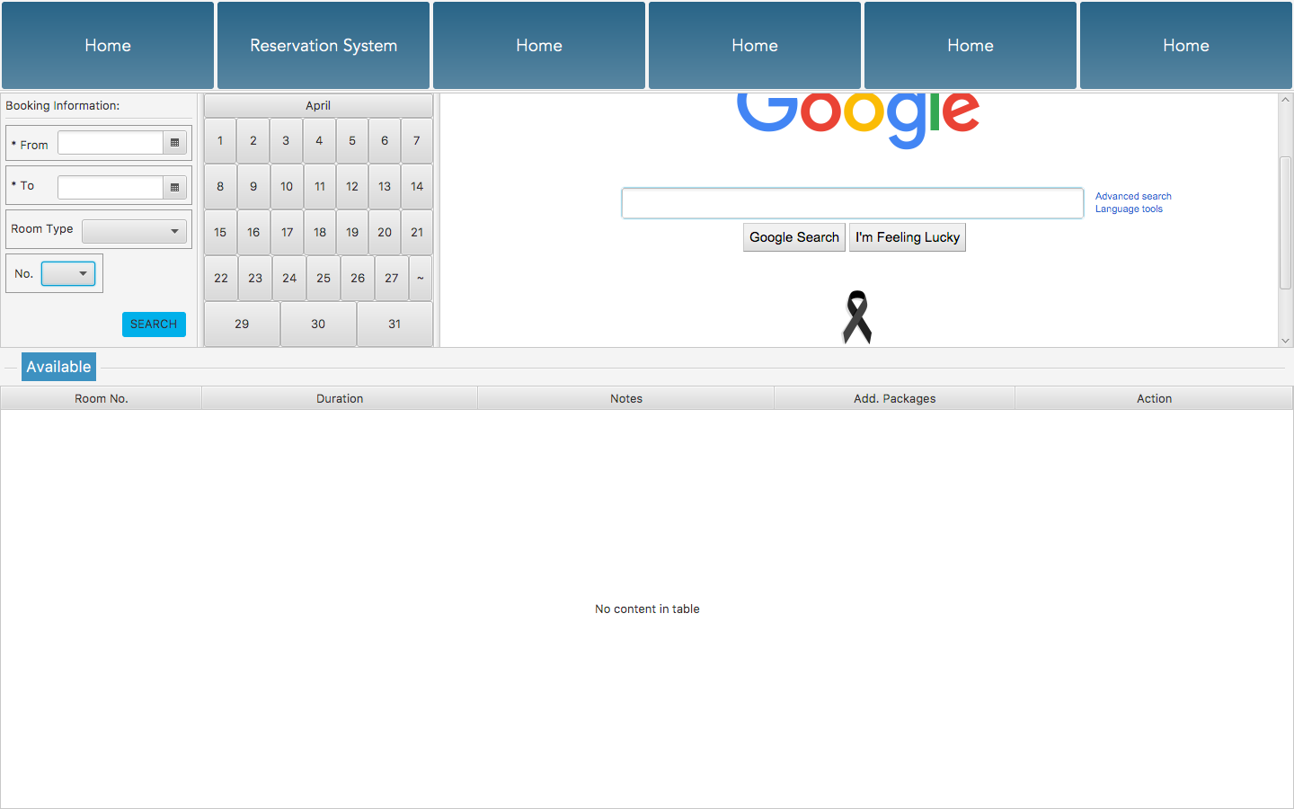

Slide 16
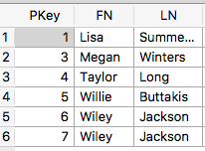
Database Of Names
Using SQLite we created a date base table that contains first and last name of guest.

